Slide 1
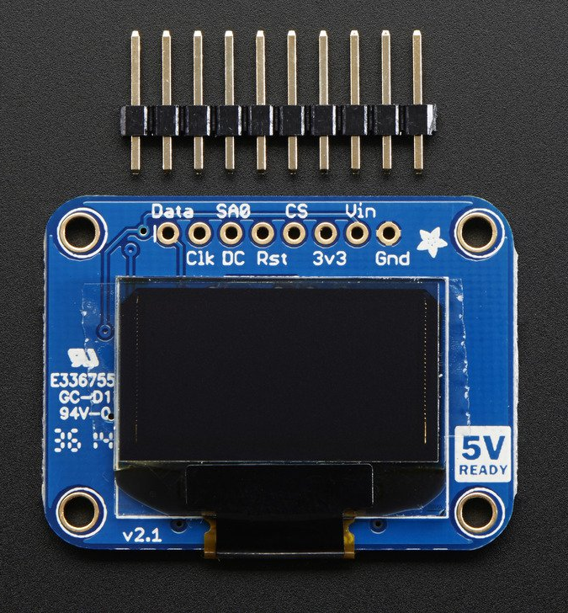
SSD1306 Monochrome OLED DISPLAY
Presented by: Delroy Christie

Slide 2
INTRODUCTION
Proposal
As a student in the Computer Engineering Technology program, my goal was to integrating the knowledge and skills I have learned from our program into this IoT themed project.
So the aim of my project was to connect my SSD1306 Monochrome OLED display sensor/effector to the Broadcom development platform (AKA Raspberry Pi) to display texts and images pulled from an external source. This is a small part of the broader objective for next semester, which is to integrate sensor with the other two sensors from my group (accelerometer and capacitive touch sensor) to create a real world IoT device which connects to an external database through an android mobile application which we developed.
The internet connected hardware will include a custom PCB with the sensors for measuring distances and touch, and the database will store the data generated from the sensors.
Thus far, I have worked thirteen weeks on the project, culminating into today’s presentation.

Slide 3
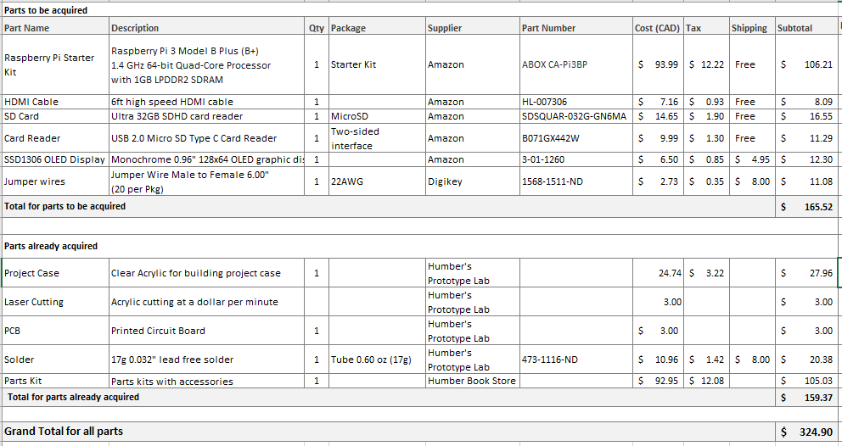
budget

Slide 4
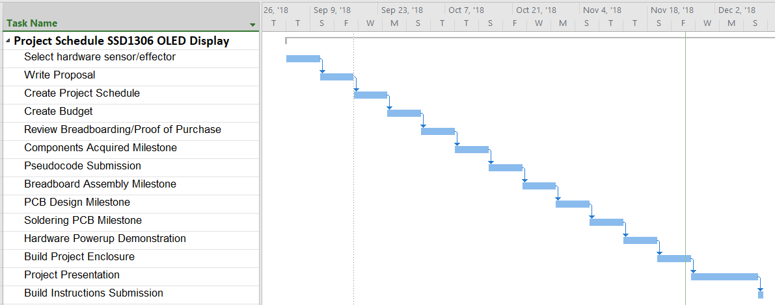
schedule

Slide 5
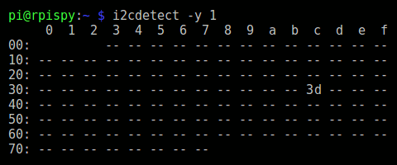
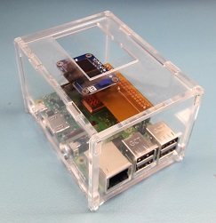
images
SSD1306 I2C Address
Project Enclosure

Slide 6
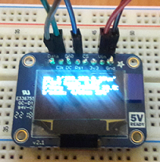
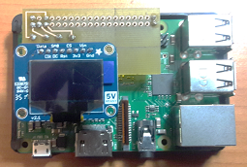
Writing to SSD1306 OLED Broadcom Development Platform with Stackable Header

Slide 7
knowledge utilized from previous courses
In order to have completed this project, the knowledge garnered from previous courses was applied. The courses that were a direct contributing factor to the successful completion of this project are:
TECH 150 Electronic devices and circuits
TECH 153 Technical C
WRIT 220 Technical Workplace Writing Skills
CENG 209 Micro Assembly Programming
CENG 215 Digital And Interfacing Systems
CENG 216 Introduction to Software Engineering
CENG 251 UNIX Internals
CENG 252 Embedded Systems
CENG 317 Hardware Production Technology

Slide 8
Thank You

